Slide 1

Personalized Recipes Recommender
Hanadi bin mujalli
Capstone Project
MISK-Data Science Immersive 2022

Slide 2
01
Background
Data cleaning & Exploratory data analysis (eda)
02
Table of contents
03
recommendation systems
04
The model
05
Conclusion

Slide 3
background
01

Slide 4
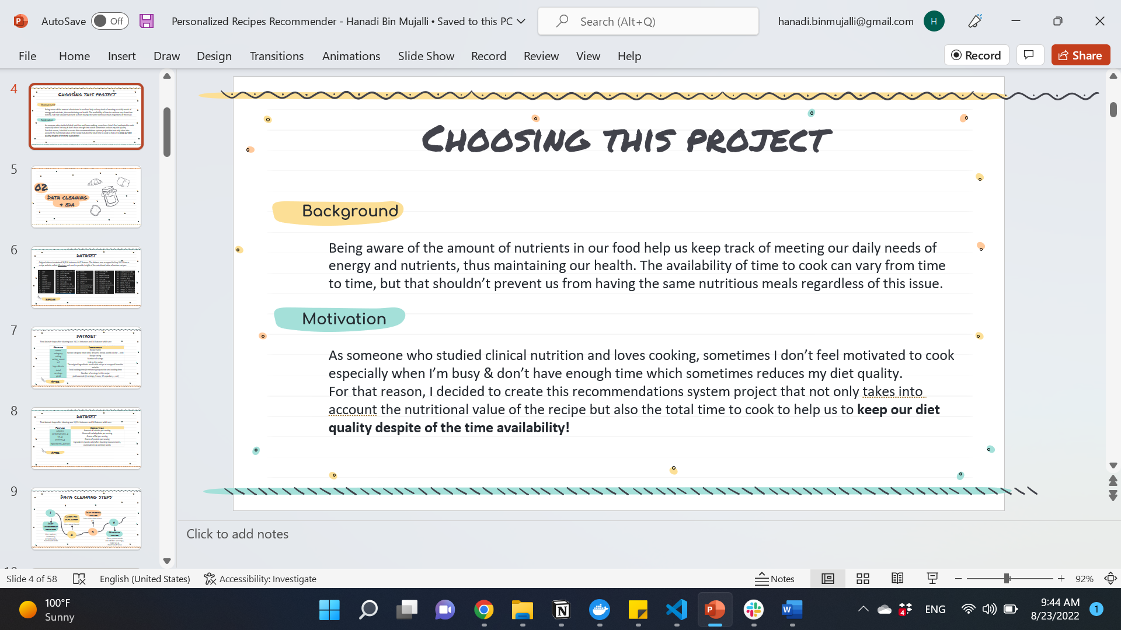

Choosing this project
Background
Meeting our daily needs of energy and nutrients helps maintaining our health.
The availability of time to cook can vary from time to time, but that shouldn’t prevent us from having the same nutritious meals.
Motivation
As someone who studied clinical nutrition and enjoys cooking, sometimes I don’t feel motivated to cook especially when I’m busy which can reduces my diet quality.
Goal
Create a recommendations system that takes both nutritional value of the recipe & total cooking time to help keeping our diet quality despite of time availability!

Slide 5
Data cleaning & eda
02

Slide 6
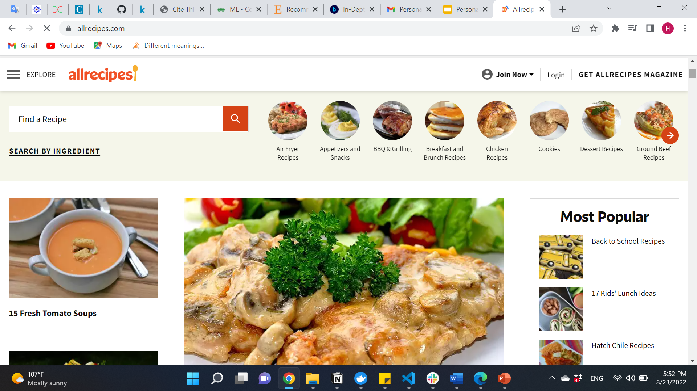
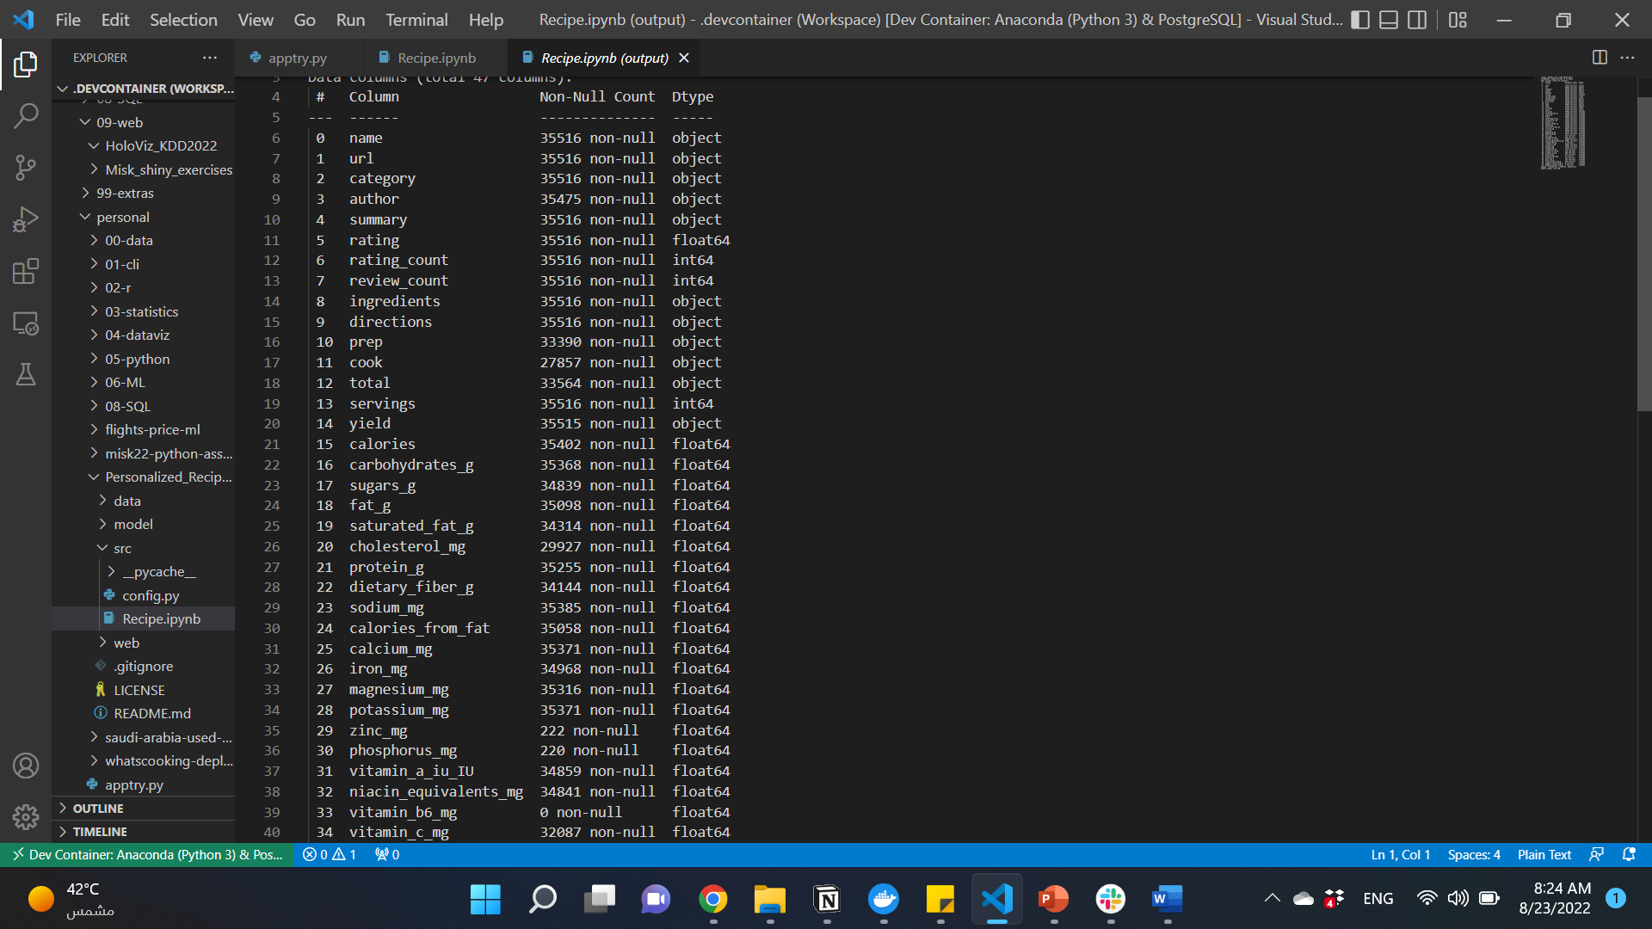
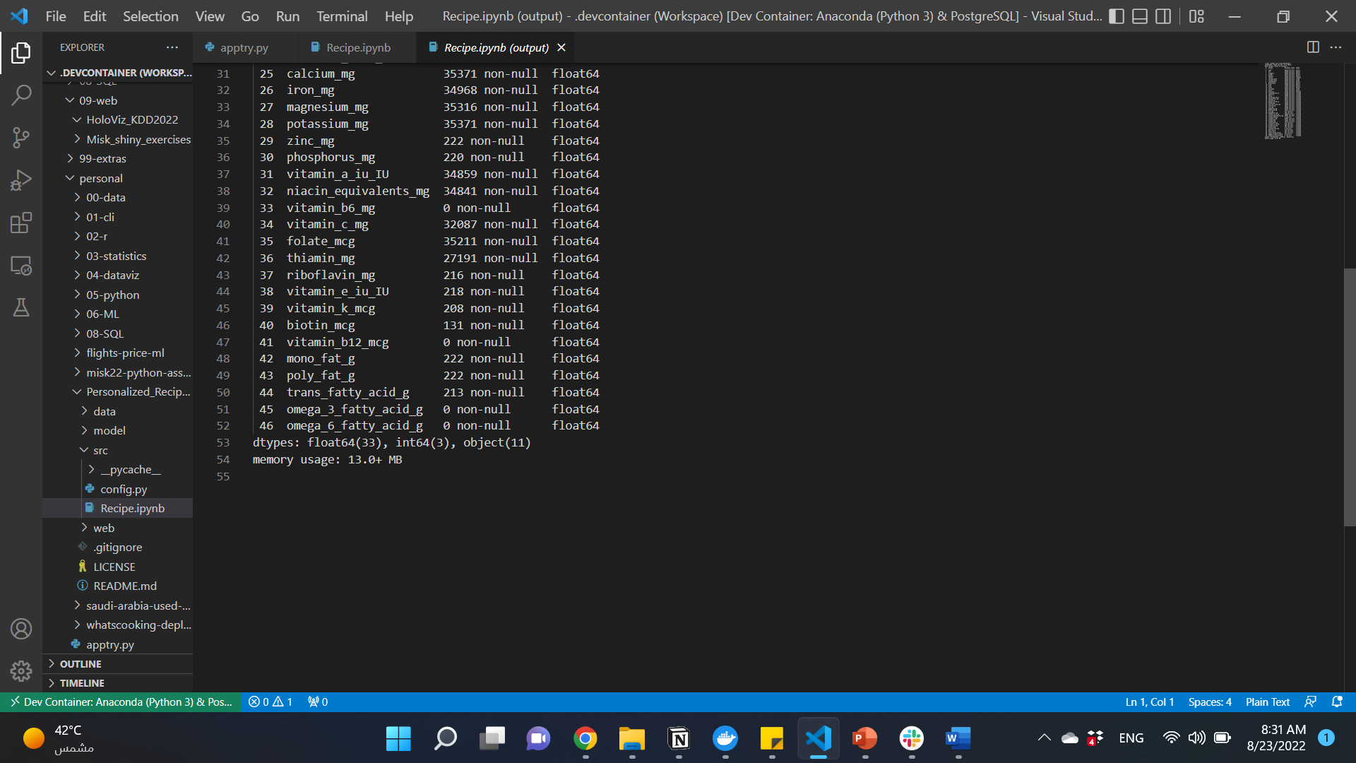
dataset
Original dataset contained 35,516 recipes & 47 features. The dataset was scrapped in May 2021 from a recipe website called Allrecipes and used to provide insight of the nutritional value of various recipes.
before
Original data source: https://github.com/shaansubbaiah/allrecipes-scraper/tree/main/export. Scrapped https://www.allrecipes.com/

Slide 7
Dataset Processing
Final dataset shape after cleaning was 19,179 recipes and 14 features which are:
Feature | Description
name | Recipe name
category | Recipe category (main dish, desserts, bread, world-cuisine ... ect)
rating | Recipe rating
rating_count | Number of ratings
url | Link to the recipe
Ingredients | The original ingredients used as scrapped from the website
total | Total cooking time (in minutes) preparation and cooking time
servings | Number of servings in this recipe
yield | yield example (4 servings, 3 cups, 12 cupcakes, ... ect)
After

Slide 8
Dataset Processing
Final dataset shape after cleaning was 19,179 recipes and 14 features which are:
Feature | Description
calories | Amount of calories per serving
carbohydrates_g | Grams of carbohydrate per serving
fat_g | Grams of fat per serving
protein_g | Grams of protein per serving
ingredients_parsed | Ingredients (words only) after cleaning measurements, punctuations & common words
After

Slide 9
Data cleaning steps
1
Drop missing values
Check for duplicates
Less than 5%
4
Drop irrelevant features
Non were found
Dealing with outliers
3
like: author, summary, directions & micronutrients (vitamin & minerals)
2
Set a reasonable cut-off for time, servings, calories & macronutriens (carb, fat & protein)

Slide 10
Data cleaning steps
Drop irrelevant ingredients for target users
5
Clean the ingredients
Such as pork, wine, ect..
Convert cooking time
8
From detailed sentences to words
7
From string (1 hr 30 min) to integer (90)
Remove irrelevant recipes
6
Such as recipes for seasonings

Slide 11
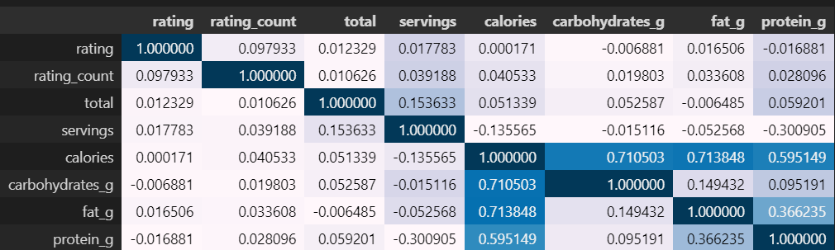
EDA
Correlation matrix
Insight: As expected, there's a correlation between calories and carb, fat & protein. Additionally, fat correlated with protein.

Slide 12
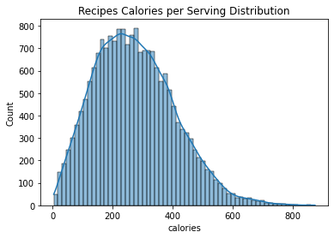
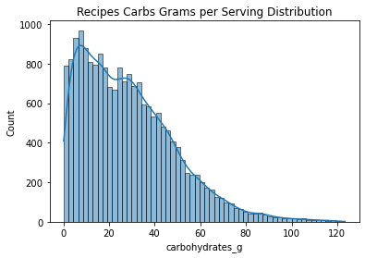
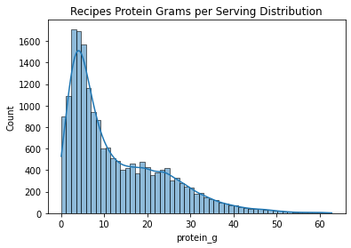
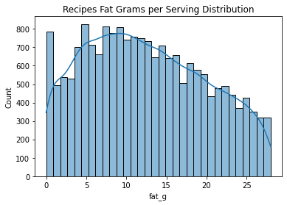
EDA
Insight: Calories & nutrients are positivly skewed except for fat.

Slide 13
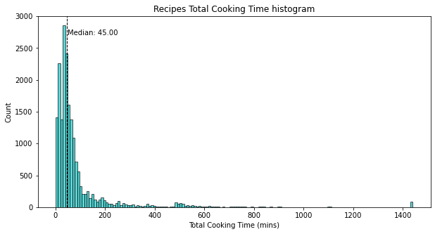
EDA
Insight: Time was positively skewed, most of recipes takes lower time to cook.

Slide 14
recommendation systems
03

Slide 15
Recommendation systems
Types
Colaberative-filtering
Content-based
Works by recommending an items to a specific user when this item is preferred by similar users.
Works by recommending an item to a user after collecting data from that user either explicitly or implicitly.

Slide 16
Content-based Recommendation systems
Approach used
Recommending Items to Users Based on Content With profile vectors for both users and items, we estimate the degree to which a user would prefer an item by computing the distance metrics between the user’s and item’s vectors.

Slide 17
The model
04

Slide 18
Challenges & tries
Challenges
Removing irrelevant recipes or ingredients.
The dataset contains only data about recipes. So, I had to create a user vector to collect user’s input.
Things that i tried that didn't work
Creating an external user vector as a list.

Slide 19
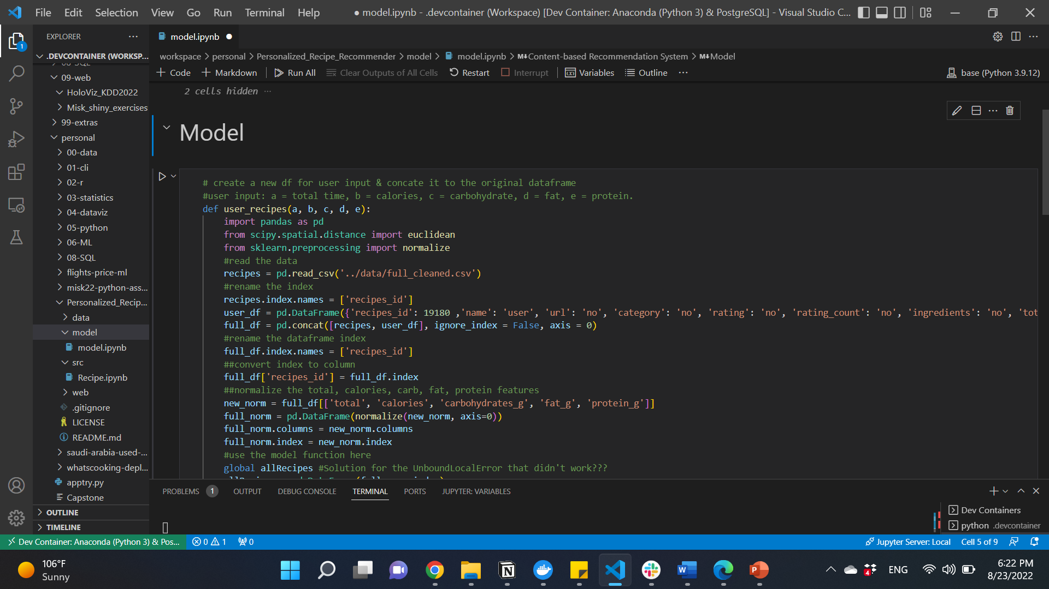
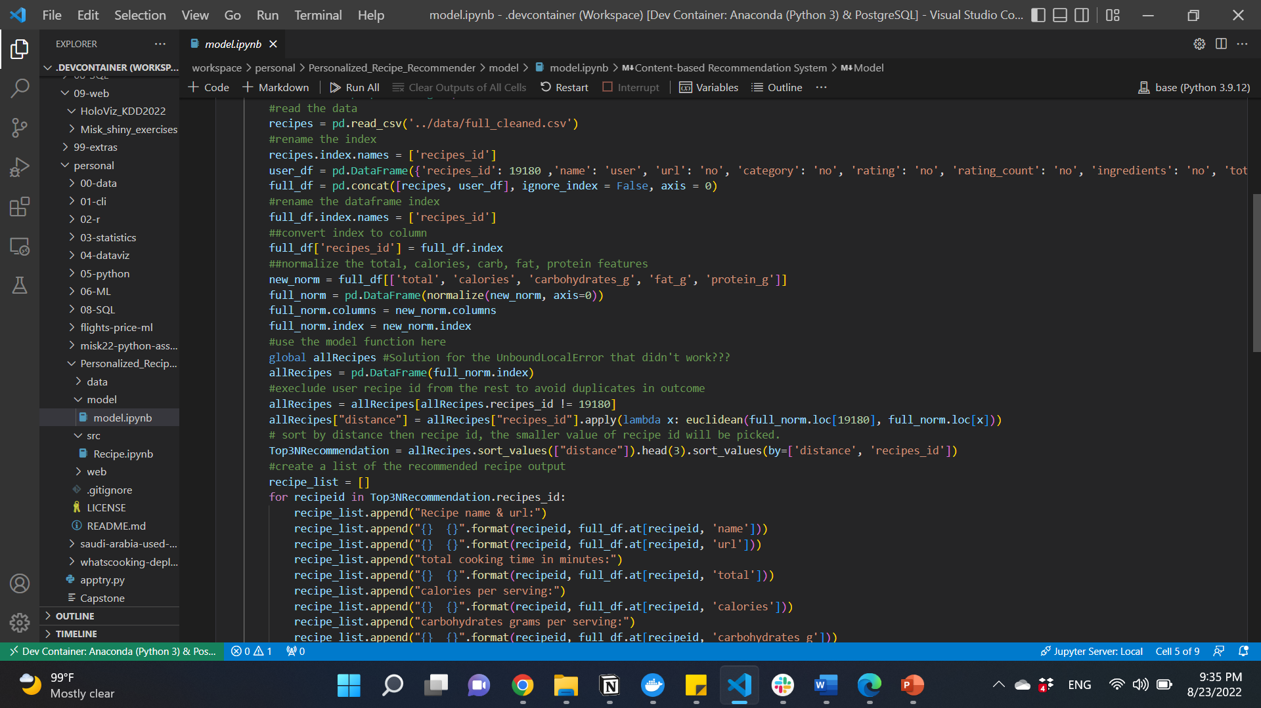
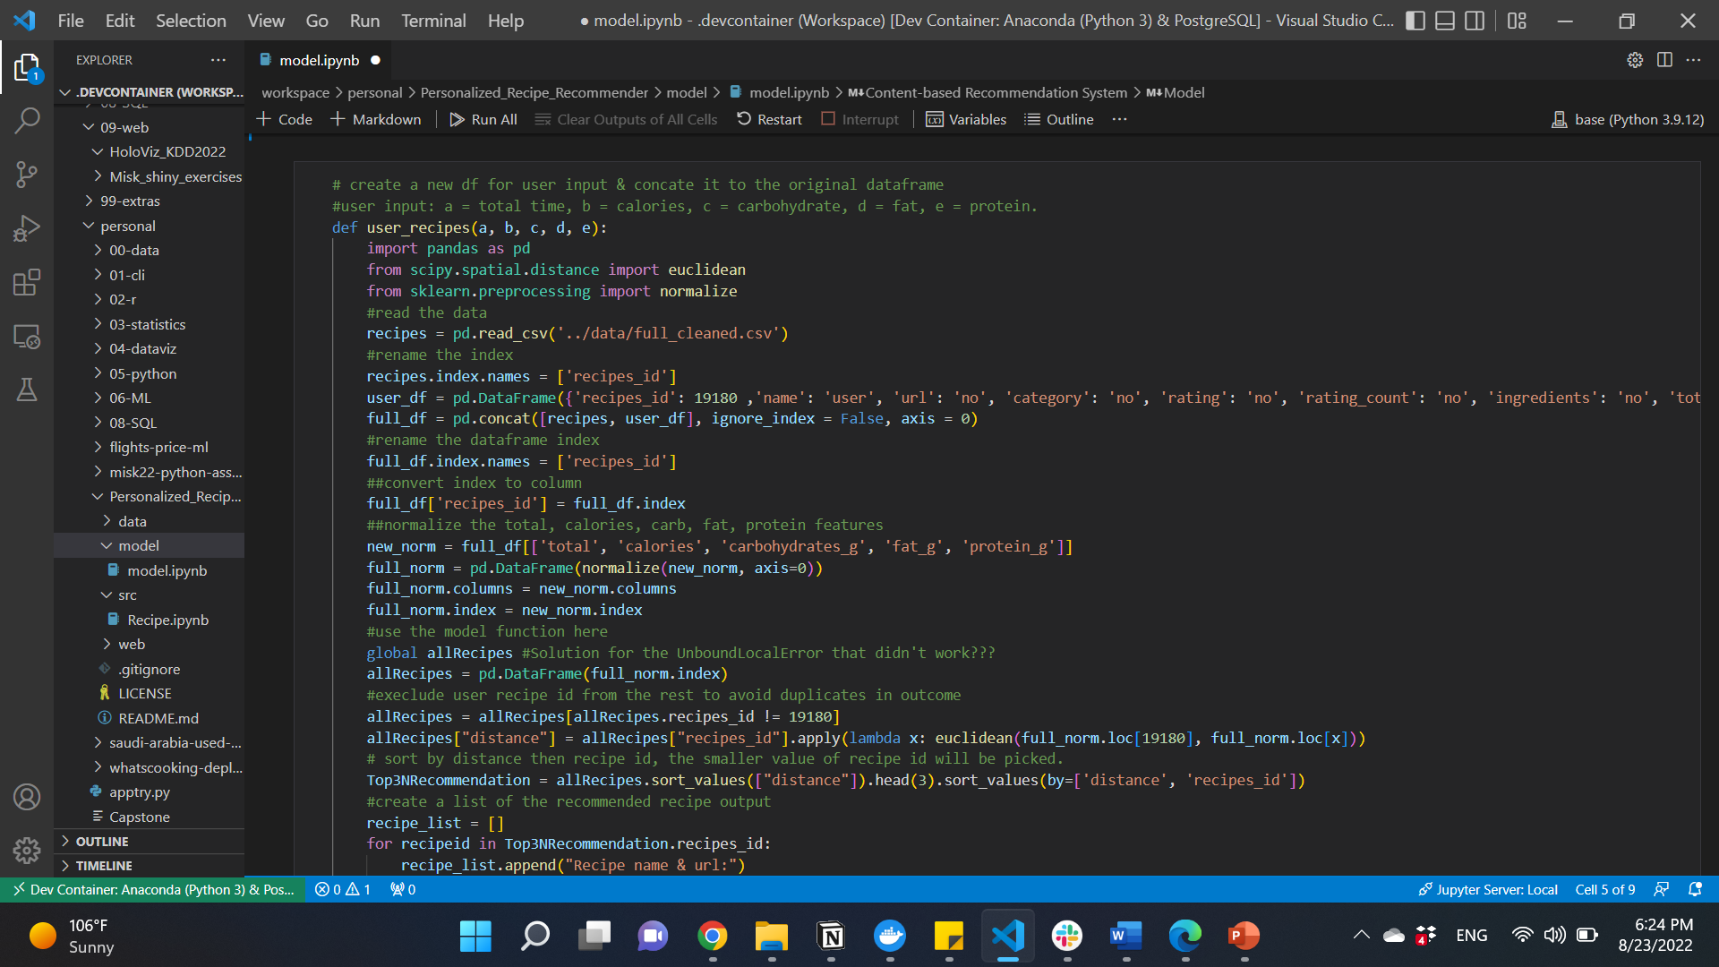
The model
steps to find solution
Function for user input (a=time, b=calories, grams of c=carbohydrates, d=fat & e=protein/serving).
Convert the data index to column.
Save input in dictionary & converted it to data frame.
Concatenate it to the original data.
Normalize these features for the whole new dataset.

Slide 20
The model
steps to find solution
5. Apply the distance function.
6. Sort by distance.
7. Recommend top 3 & give the name, url, time, calories, carbohydrates, fat & protein.

Slide 21
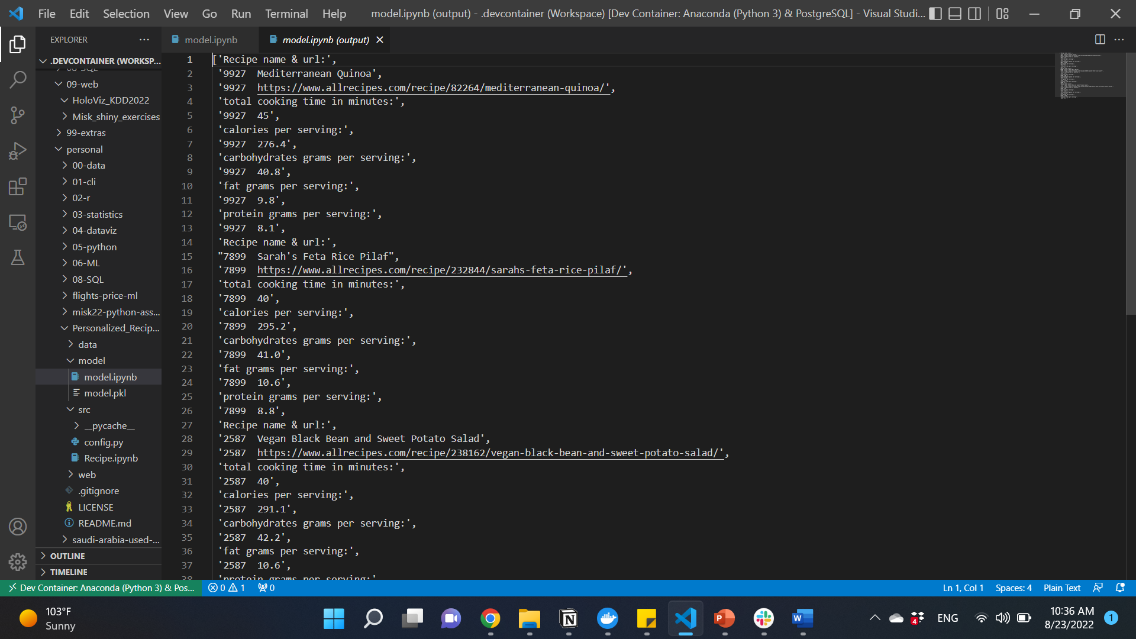
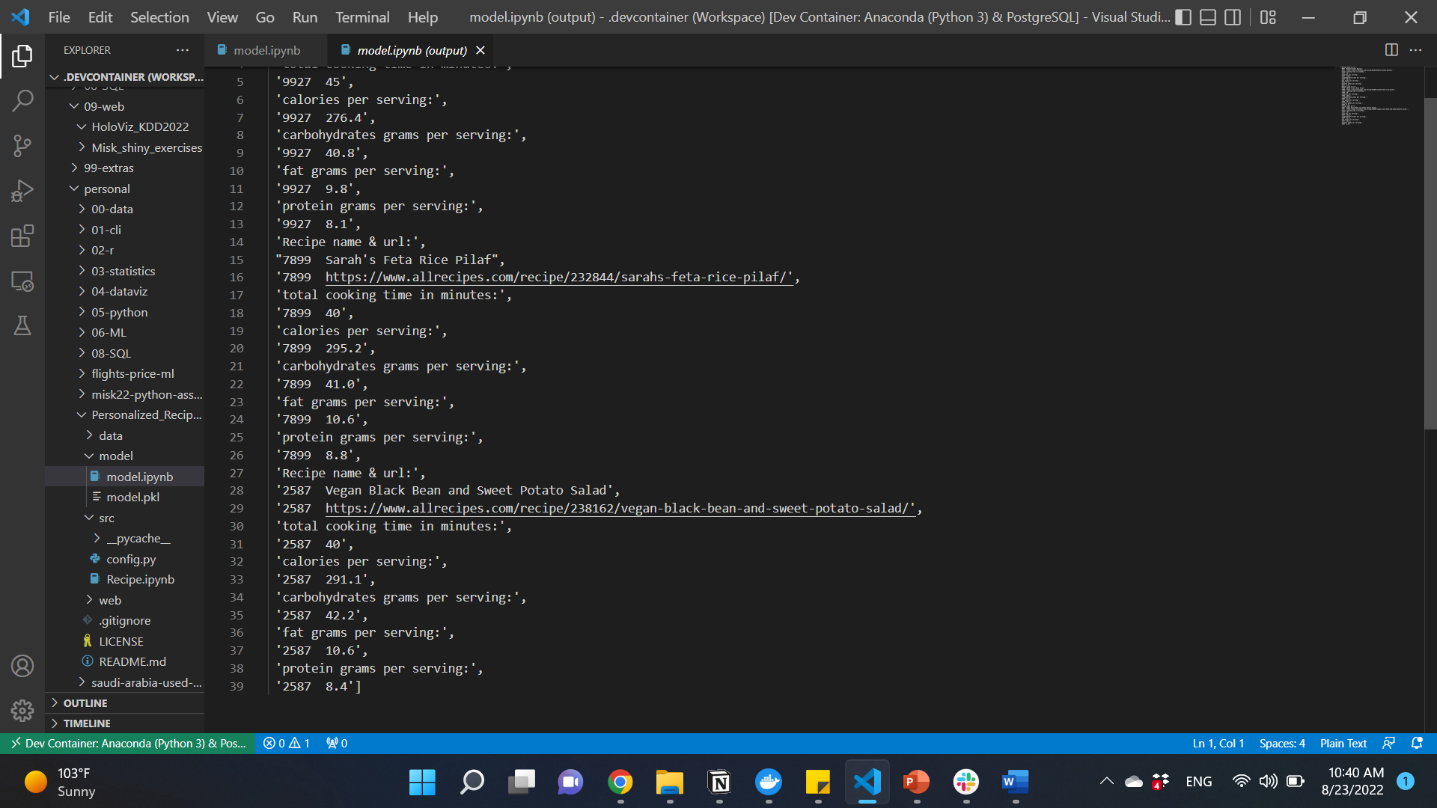
Model demo
Let’s assume that the user wants a recipe that takes 45 minutes to cook, 300 calories, 40 gm of carbs, 9 gm of fat, 8 gm of protein per serving, putting these info in the model function will give:
1
2
3

Slide 22
Conclusion
05

Slide 23
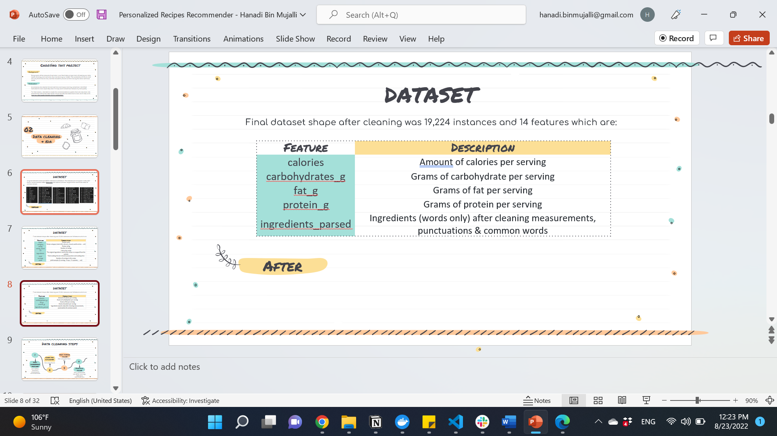
Conclusion
Take home massage: personalized solutions have the advantage in considering different aspects form each person & provide solution according to that.
Limitations: needs prior knowledge about calories & macronutrients, not having an option for different diets such as vegetarians, vegan.
For future improvement: use Arabic dataset to be more relevant, add an ingredients option (to include or exclude) incase of allergies, food availability or religious believes.

Slide 24
References
1. Human energy requirements. Retrieved 23 August 2022, from https://www.fao.org/3/y5686e/y5686e04.htm
2. Subbaiah, S. (2021). GitHub - shaansubbaiah/allrecipes-scraper: 🥗 Scrapy spider to scrape recipe and nutritional data from allrecipes.com. Retrieved 23 August 2022, from https://github.com/shaansubbaiah/allrecipes-scraper 3. Chapter 9 Recommendation Systems. Retrieved 25 August 2022, from http://infolab.stanford.edu/~ullman/mmds/ch9.pdf 4. ML - Content Based Recommender System - GeeksforGeeks. (2020). Retrieved 23 August 2022, from https://www.geeksforgeeks.org/ml-content-based-recommender-system/
5. Shimodaira, H. (2015). Similarity and recommender systems. Retrieved 23 August 2022, from https://www.inf.ed.ac.uk/teaching/courses/inf2b/learnnotes/inf2b-learn-note02-2up.pdf 6. C program to find the Euclidean distance between two points - GeeksforGeeks. (2021). Retrieved 23 August 2022, from https://www.geeksforgeeks.org/c-program-to-find-the-euclidean-distance-between-two-points/

Slide 25
Thank You
Dr. rick scavetta
Lujain Felemban
My colleagues
MISK

